Slide 1
Steganography
-behind the images
TEAM DETAILS : J. JUHITHA (2103A51321)
B. SREETEJA (2103a51305)
B. SAI HRUSHITH (2103a51084)
K. BHARADWAJ (2103A51169)
M. MAHESH KUMAR (2203A51L32)
GUIDE DETAILS: K. SUDHEER KUMAR
SR UNIVERSITY

Slide 2
contents
Abstract
Methodology
Algorithm
Implementation and Results
Objectives
Usecases
Literature survey
Proposed system
Existing system
Futurescope
Conclusion
References

Slide 3
Abstract
Image steganography using passwords developed with python programming is a technique for hiding secret information inside an image while encrypting it with a password to ensure security. This method involves utilizing the LSB (least significant bit) algorithm to embed the secret message into the pixels of the cover image. The password is then used to encrypt the secret message and the modified cover image using an LSB algorithm. The developed program provides an intuitive and easy-to-use interface for users to select the cover image, input the secret message and password, and generate the steganographic image. The program utilizes python libraries such as tkinter to implement the steganography algorithm and encryption process. This technique offers a high level of security and confidentiality for communication and data exchange. The program is efficient, reliable, and can be used for various applications that require secure communication and data exchange.

Slide 4
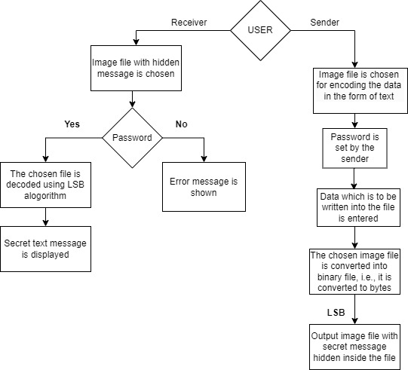
Methodology
The application is based on the user. Here users are the receiver and sender.
When the user is the sender, the user needs to specify the image file in which he want to hide the message and need to give the secret message. Before this step the user needs to specify the secret password. The secret message is hidden in the file using the LSB method. Now the file is along with the secret file but in binary format. The binary file is again converted back to a normal file using LSB.
When the user is the receiver, first the user needs to enter the password, if the password does not match then error message is shown. If the password matches then the user can get the secret message.

Slide 5

Algorithm
We can describe a digital image as a finite set of digital values, called pixels. Pixels are the smallest individual element of an image, holding values that represent the brightness of a given color at any specific point. So we can think of an image as a matrix (or a two-dimensional array) of pixels which contains a fixed number of rows and columns.
Least Significant Bit (LSB) is a technique in which the last bit of each pixel is modified and replaced with the secret message’s data bit.

Slide 6
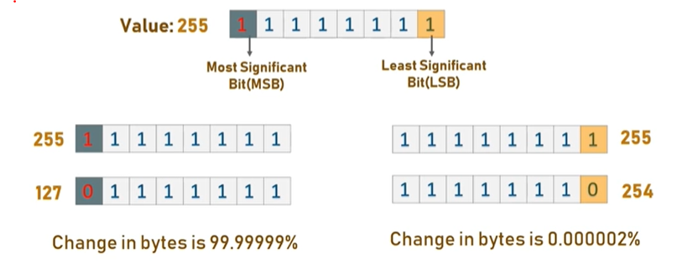
From the image it is clear that, if we change MSB it will have a larger impact on the final value but if we change the LSB the impact on the final value is minimal, thus we use least significant bit steganography.

Slide 7
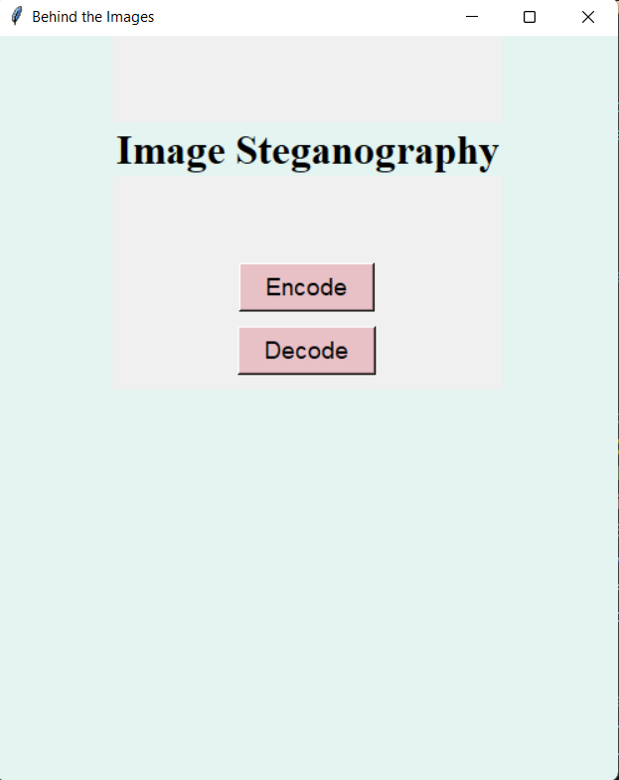
IMPLEMENTATION AND RESULTS
Interface to select the encoding process or decoding process.

Slide 8
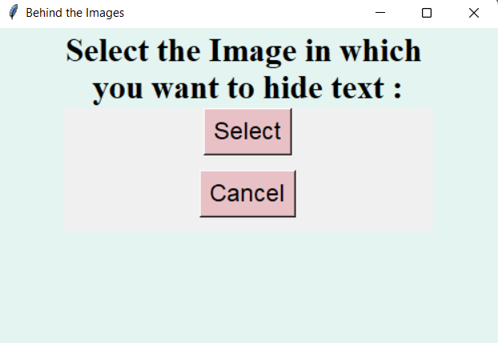

Behind the scenes of encoding
Window for image selection.
Selecting the image from your device.

Slide 9
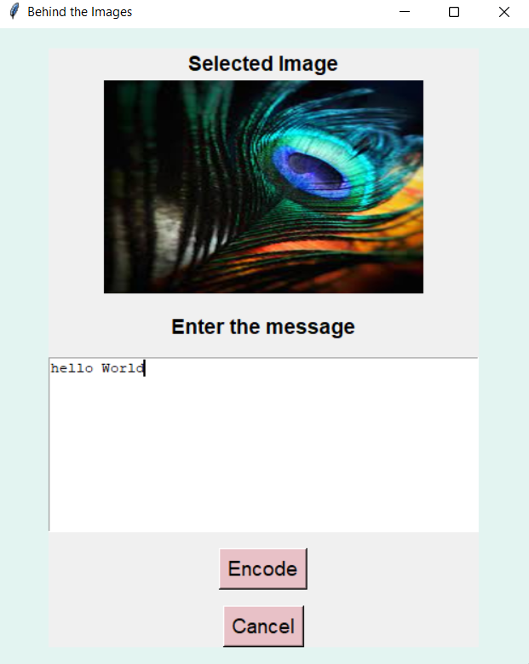
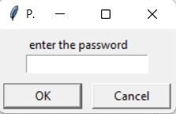
Before Encoding the image set a password.
Enter the Secret information.

Slide 10
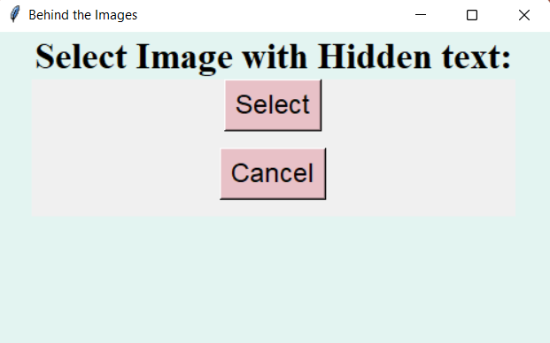
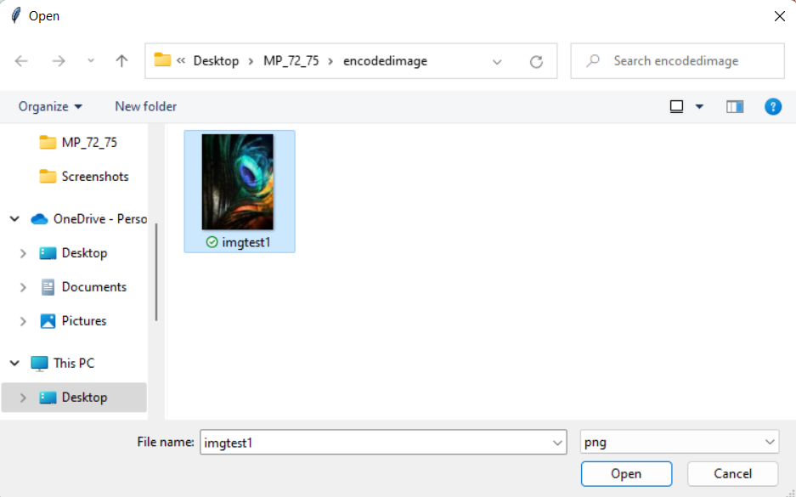
Behind the scenes of Decoding
Window for selecting the hidden text image.
The image which has the hidden message is selected.

Slide 11
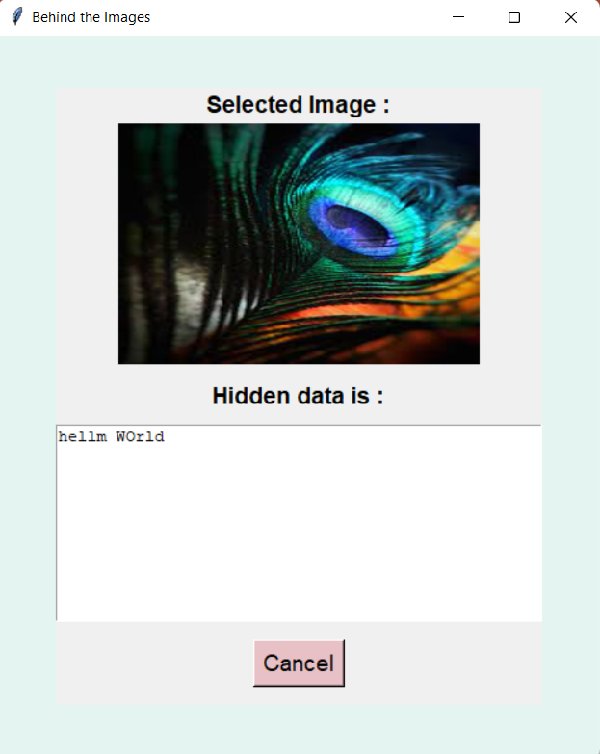
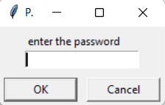
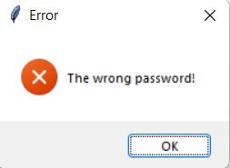
The password given by the user should be correctly entered by the receiver in order to get the hidden text.
If the password entered is Wrong. The below error message is shown.
The secret message is finally revealed out.

Slide 12
objectives
Steganographic embedding
Password protection while encoding
Password authentication before decoding
Enhanced security measures

Slide 13
LITERATURE SURVEY
Literature Survey Steganography is the art of concealing cryptic messages or data within an innocuous medium in kind that the presence of the message is undetectable. These methods are broadly used in many areas such as military, intelligence, and cybersecurity to protect information from unauthorized access. Here is a literature survey on steganography: "A Survey of Steganography Techniques in Image, Audio and Video Files" by S. S. Maitra and S. K. Bakshi. This paper gives a thorough survey of the different types of steganography methods used in image, audio and video files. The paper review the pros and cons of each method and also provides a comparison between the techniques. "A Review of Audio Steganography Techniques" by R. P. Singh and P. Gupta. This paper focuses on the steganography techniques used in audio files. The paper presents a comprehensive survey of the distinctive types of audio steganography methods . 9 "A Review of Text Steganography Techniques" by A. Jain and A. Kumar. This paper presents a survey of the distinctive types of text steganography methods. The paper provides an overview of the different techniques used for hiding information in text files. "A Survey of Steganography in Social Media" by J. M. Al-Jarrah and A. M. Al-Qadi. This paper provides a comprehensive survey of steganography techniques used in social media. The paper reviews the pros and cons of each methodology and also provides a comparison between them. "A Review of Steganalysis Techniques for finding Hidden Information" by V. K. Sharma and R. Kumar. This paper focuses on steganalysis methods used for detecting concealed data. The paper provides an overview of the distinctive methods used for finding concealed data in image, audio, and video files. "A Survey of Steganography Techniques in Cloud Computing" by Y. Zhang, C. Wang, and X. Liu. This paper presents a survey of the distinctive types of steganography methods used in cloud computing. The paper provides an summary of the distinctive methods used for hiding information in cloud storage systems. "A Review of Steganography Techniques in Biometric Systems" by R. S. Das and S. K. Lenka. This paper presents a survey of steganography techniques used in biometric systems. The paper reviews the distinctive types of steganography methods used in biometric systems and also provides a comparison between them. These papers provide a complete summary of the different types of steganography methods used in various fields. They also discuss the advantages and disadvantages of each technique and provide a comparison between the techniques

Slide 14
EXISTING SYSTEM
There are several existing systems for image steganography that do not use password ENCRYPTION.
These systems primarily use the LSB algorithm to hide the cryptic message in THE IMAGE.
One of the most popular methods is LSB substitution, which includes substitution the
LSB of each pixel in the digital cover image with the equivalent bit of the cryptic message.
Another method is LSB matching, which involves modifying the LSBs of the cover image to
match the secret message. These techniques are simple and efficient, but they lack security
since anyone who has access to the steganographic image can extract the hidden message.
Other existing systems use more sophisticated algorithms to improve security, such as the
Discrete Cosine Transform (DCT) and the Discrete Wavelet Transform (DWT). These methods
involve converting the image to a distinctive domain, where the secret message is embedded,
and then transformed back to the image domain. These methods provide increased security, but
they are more complex and require more processing power.
Overall, the existing systems for image steganography are effective in hiding the secret
message, but they lack the added security of password encryption. Therefore, there is a need
for a more robust system that uses password encryption to ensure the confidentiality and
security of the hidden message.

Slide 15
PROPOSED SYSTEM
The application is based on the user. Here users are the receiver and sender.
When the user is the sender, the user needs to specify the image file in which he want to hide
the message and need to give the secret message. Before this step the user needs to specify
the secret password. The cryptic message is concealed in the file using the LSB method. Now
the file is along with the secret file but in binary format. The binary file is again converted
back to a normal file using LSB.When the user is the receiver, first the user needs to enter the password, if the password does
not match then error message is shown. If the password matches then the user can get the secret
message.

Slide 16
FUTURE SCOPE
Advancements in deep learning: the use of deep learning techniques in image steganography can improve the security and efficiency of the technique. Neural networks can be trained to identify and extract hidden messages, which can be used to develop more secure steganography algorithms.
Improved steganalysis techniques: with the advancements in steganalysis techniques, it has become easier to detect hidden messages in images. Future developments in steganography will focus on developing techniques that are more resistant to detection by steganalysis algorithms.
Integration with blockchain technology: the integration of steganography with blockchain technology can provide a secure and tamper-proof method for transferring sensitive information. Steganography can be used to hide information within the blockchain, ensuring that the information is only accessible to authorized users.

Slide 17
CONCLUSION
Image steganography using passwords is a popular technique for hiding secret information within an image. This technique involves the use of a secret password to encrypt the hidden message before embedding it into the image. The password is required to extract the hidden message from the image.
The advantage of using passwords in image steganography is that it provides an extra layer of security, as unauthorized users will not be able to extract the hidden message without the password. This makes the technique more secure compared to other image steganography techniques that do not use passwords.
However, the security of image steganography using passwords depends on the strength of the password. If the password is weak or easily guessable, it can be easily cracked, compromising the security of the hidden message. Therefore, it is important to use strong and complex passwords for image steganography.
In conclusion, image steganography using passwords is a secure technique for hiding secret information within an image. However, the security of the technique depends on the strength of the password used. It is important to use strong passwords to ensure the security of the hidden message.

Slide 18
REFERENCES
1. Mehta DM, bhatti DG (2019) research review on digital image steganography which resists against compression. Springer, singapore, pp 529–534
2. Provos N, honeyman P (2003) hide and seek: an introduction to steganography. IEEE secur priv 1(3):32–44
3. Hussain M et al (2018) image steganography in spatial domain: a survey. Signal process 65:46–66
4. Das S et al (2018) A framework for pixel intensity modulation based image steganography. Progress in advanced computing and intelligent engineering. Springer, singapore, pp 3–14
5. Cheddad A et al (2010) digital image steganography: survey and analysis of current methods. Signal process 90:727–752
6. Bi N, sun Q, huang D, yang Z, huang J (2007) robust image watermarking based on multiband wavelets and empirical mode decomposition. IEEE trans image process 16(8):1956–1966
7. Li XW, kim ST (2013) optical 3D watermark based digital image watermarking for telemedicine. Opt lasers eng 51(12):1310–1320

Slide 19
Thank you

